Slide 1
MOLECULAR MARKERS OF TRASTUZUMAB RESISTANCE IN HER-2 METASTATIC BREAST CANCER PATIENTS
Dr. Mazhar Al-Zoubi
University of Pisa - Italy

Slide 2
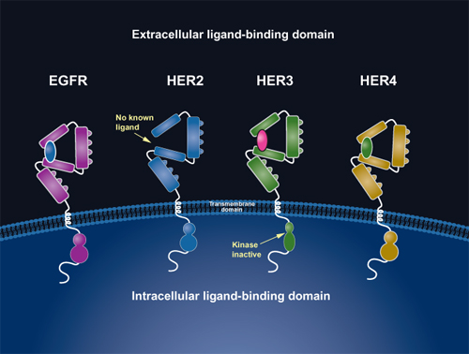
Introduction

Slide 3
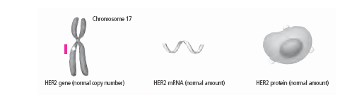
HER2 is a 185-kDa transmembrane oncoprotein (p185) encoded by HER2/neu gene located on chromosome 17 (q21.1).

Slide 4
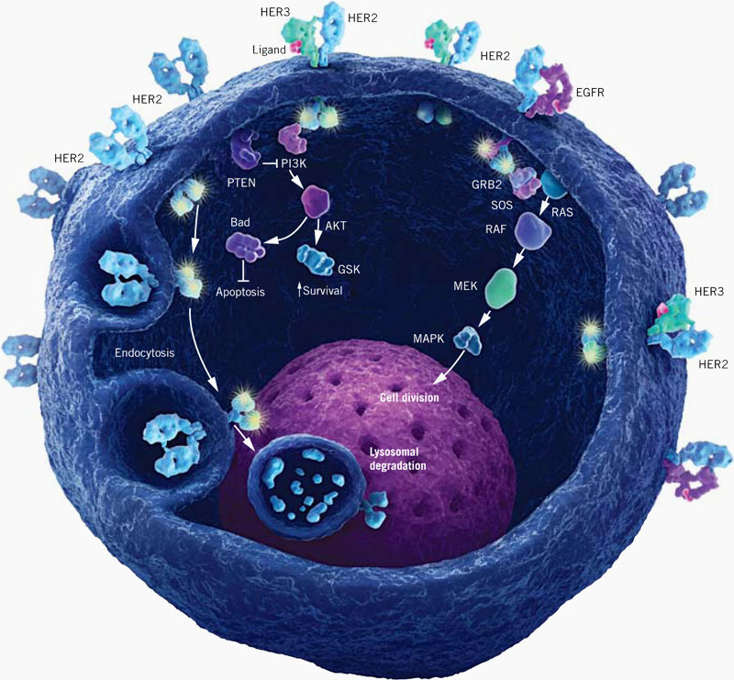

Slide 5
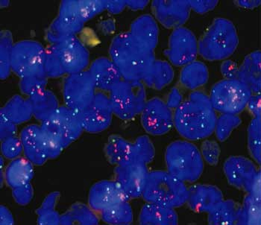
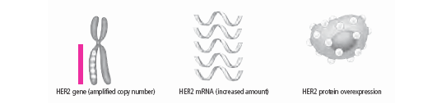
HER-2 & Effective Treatment
HER2 receptor is overexpressed in 20–30 % of BC.
Trastuzumab (Herceptin) IgG1, a monoclonal antibody, has been approved by FDA to be anti-HER2 therapy.

Slide 6

Trastuzumab Resistance
Almost 50 % do not respond to Trastuzumab-based therapy.
?
?
?
Primary.
Eventually.

Slide 7
Value
Trastuzumab costs about US$70,000 for a full course of treatment.
Trastuzumab brought = $327 million in revenue for Genentech in the fourth quarter of 2007.
    ^{Ref.}
      Fleck L (2006). "The costs of caring: Who pays? Who profits? Who panders?". Hastings Cent Rep 36 (3): 13–7.
      "Will Herceptin Media Blitz Help Or Harm Patients?". Scoop. 2006-02-14. Retrieved 2006-12-01.

Slide 8

AIM
Determination of the most probable mechanism/s of resistance
Accurate diagnosis of the implicated resistance mechanism in each subset of patients
Design of more efficient treatment protocols.

Slide 9
Trastuzumab
Mechanism of Action

Slide 10
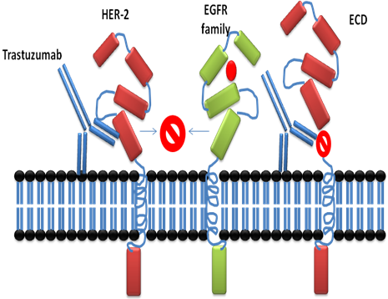

Slide 11
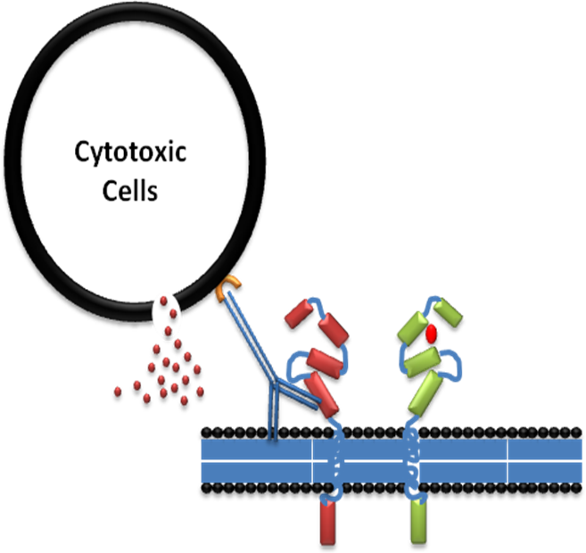

Slide 12
Trastuzumab Resistance
Proposed Mechanisms of Trastuzumab Resistance

Slide 13
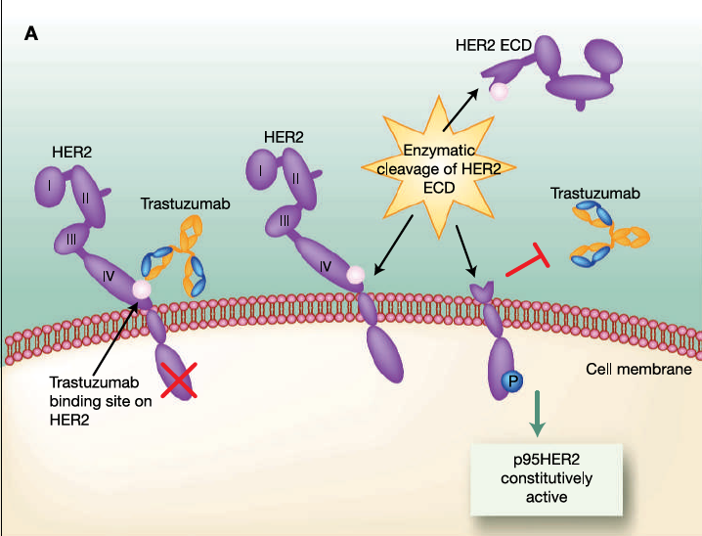
1. Obstacles for Trastuzumab Binding to HER-2:
Production of constitutively active p95HER2

Slide 14
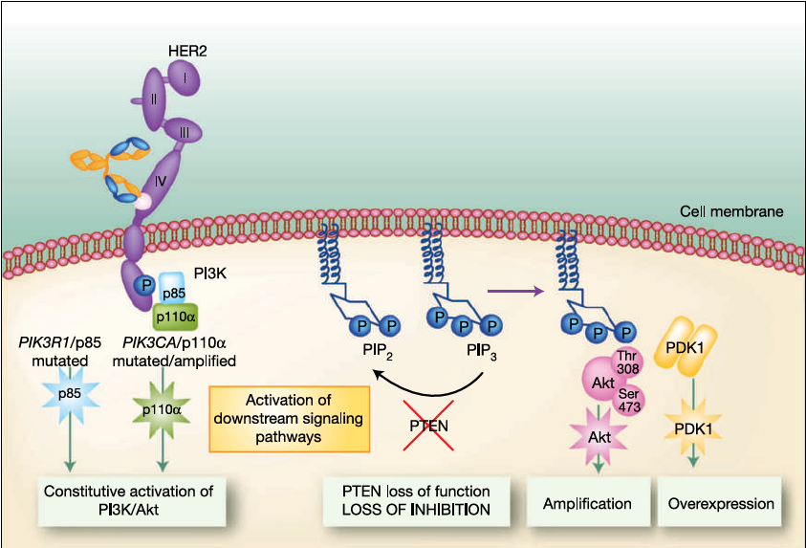
2. Upregulation of HER2 signaling pathways:
Loss of function of PTEN up to 50% of breast cancers.
PI3K mutations in either R or C subunit.

Slide 15
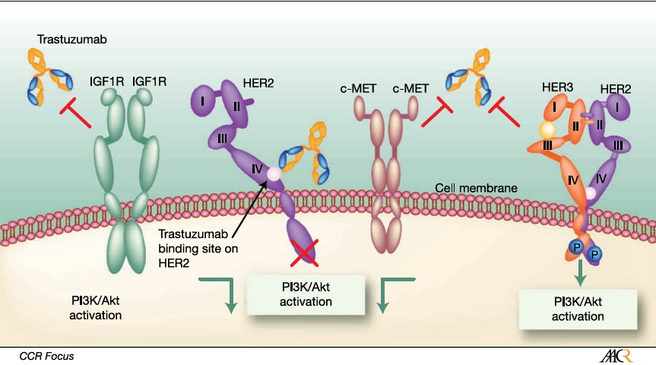
3. Signaling through alternative pathways
Insulin-like Growth Factor-I Receptor, IGF-1R.
c-Met receptor, frequently co-expressed with HER2 in cell lines.

Slide 16
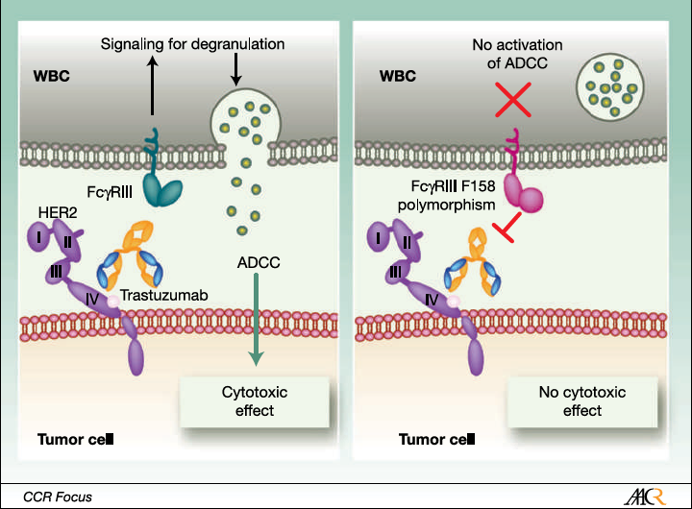
4. Failure to trigger ADCC
FcγRIIIa and FcγRIIa polymorphisms

Slide 17
Study Population
77 females with metastatic breast cancer overexpressing HER-2.
Avarage Age of Diagnosis: 55 years.
  45 % < 55 years
  55 % > 55 years

Slide 18
Gene | Exon | No. Of Mutation | % of Mutations | Total % | Total % | Total %
PIK3CA | 9 | 7/77 | 9 % | 21 % | 24 % | 38 %
 | 20 | 9/77 | 12 %
AKT1 | 4 | 2/77 | 3 % | 3 %
PTEN | 5, 7 and 8 | 14/77 | 18 % | 18 % | 18 %
HER-2 | 17-24 | 0 | 0 | 0 | 0

Slide 19
Her2/neu Mutations
Her2 Mutations are not found in
exons 17 - 24
Exon 17 SNP has been noticed.

Slide 20
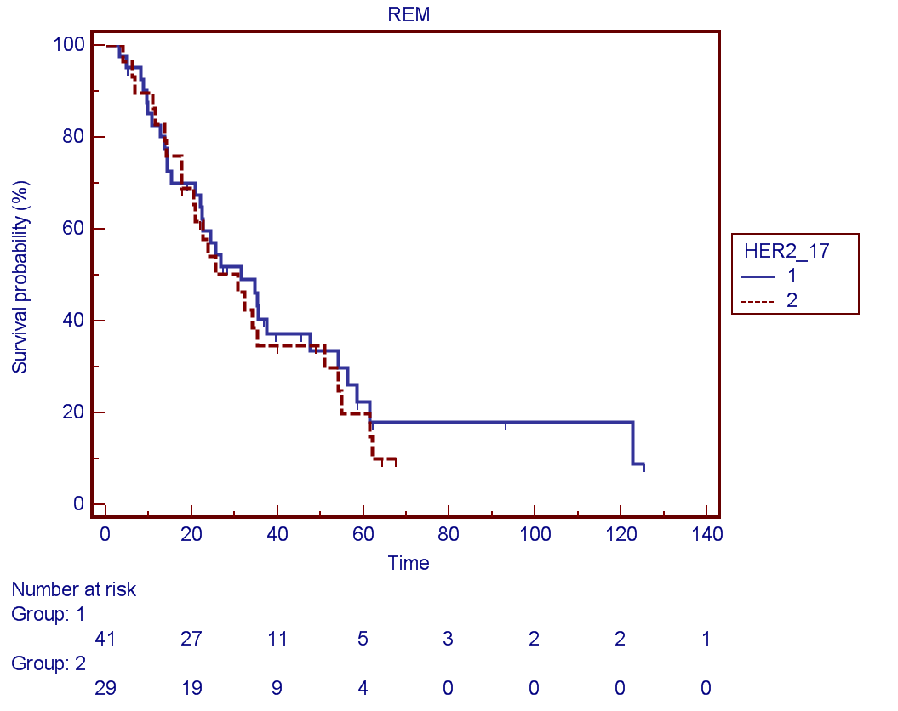
Exon 17 SNP

Slide 21
PIK3CA mutations
  Exon 9 mutations = 7 / 77 9 %
  Exon 20 mutations = 9 / 77 13 %
  Mutation in ethier Exons = 15/77
  21 %

Slide 22
Akt mutations
  Exon 4 = 2 / 77

Slide 23
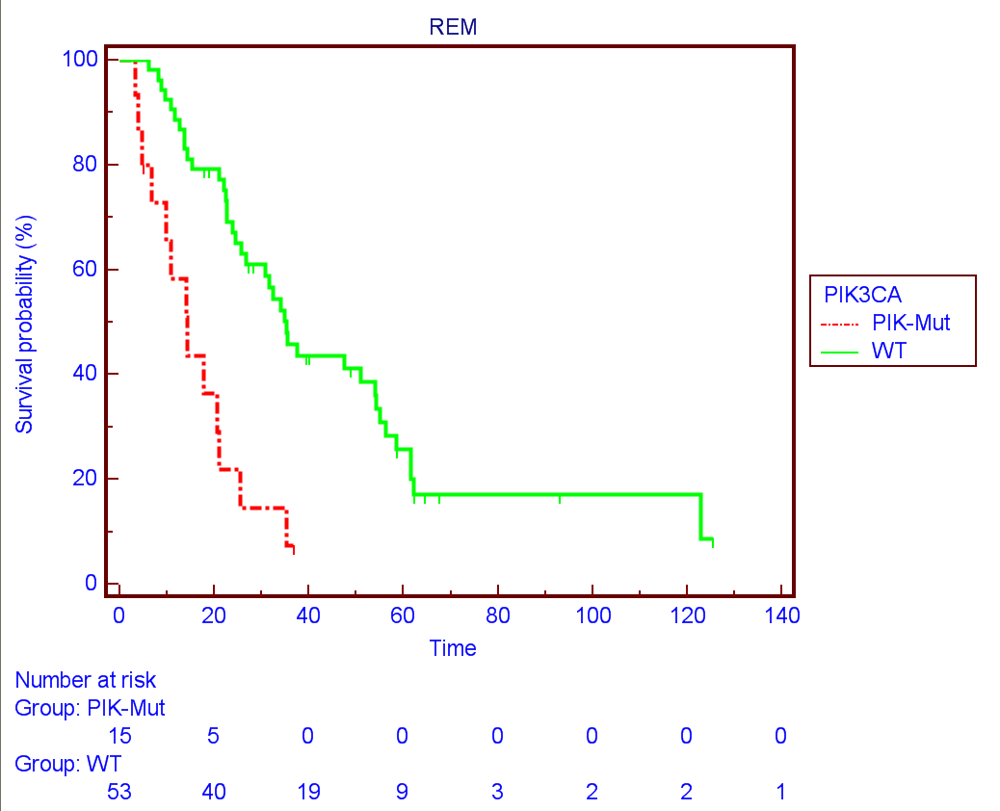
OverAll Survival (OS)

Slide 24
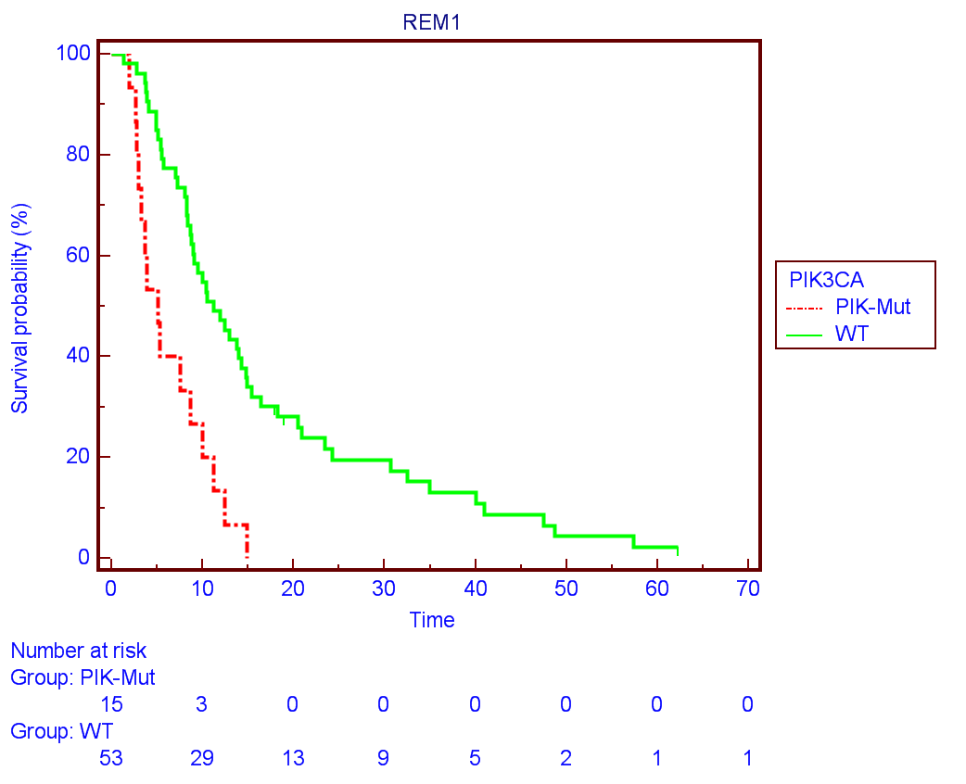
PFS-I

Slide 25
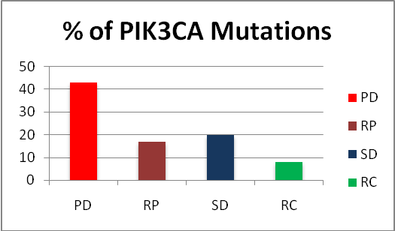
*

Slide 26
PTEN Mutations Analysis
Exon 5 7/77 = 10.2 %
Exon 7 9/77 = 13.2 %
Exon 8 2/77 = 2.9 %
5 petients have more than one muation
Total Mutated Patients 14/77 = 18 %

Slide 27
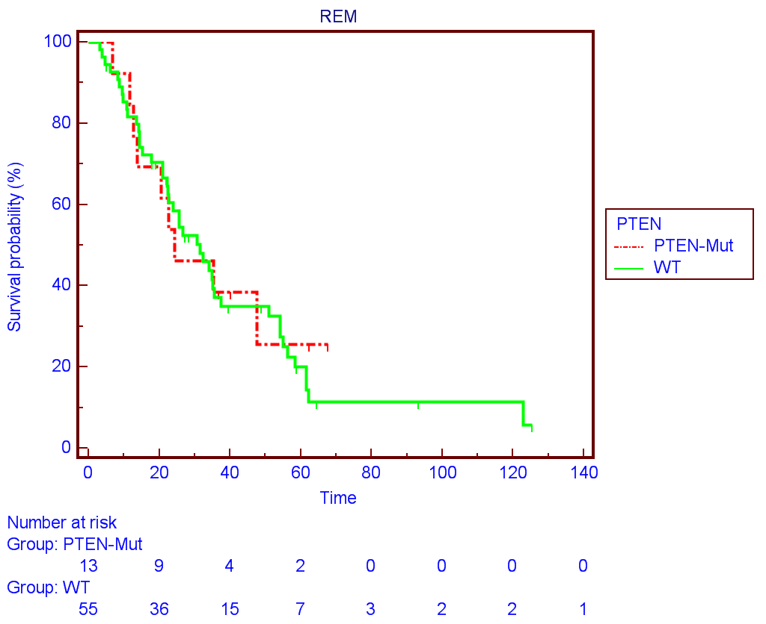
OS

Slide 28
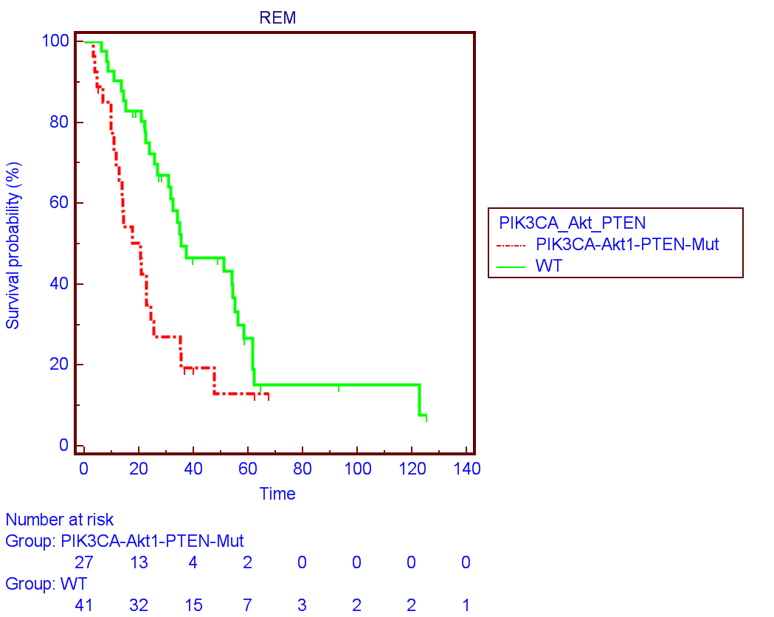
OS

Slide 29
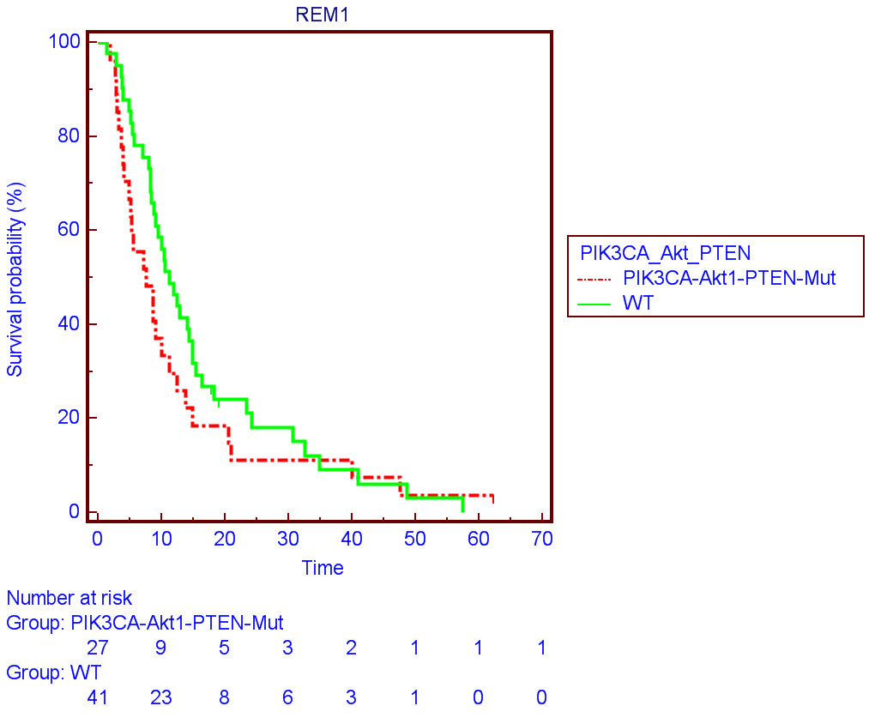
PFS-I

Slide 30



FcgRIIIa F158V and FcgRIIa R131H SNPs
FcgRIIIa or FcgRIIa
Trastuzumab
IgG1

Slide 31
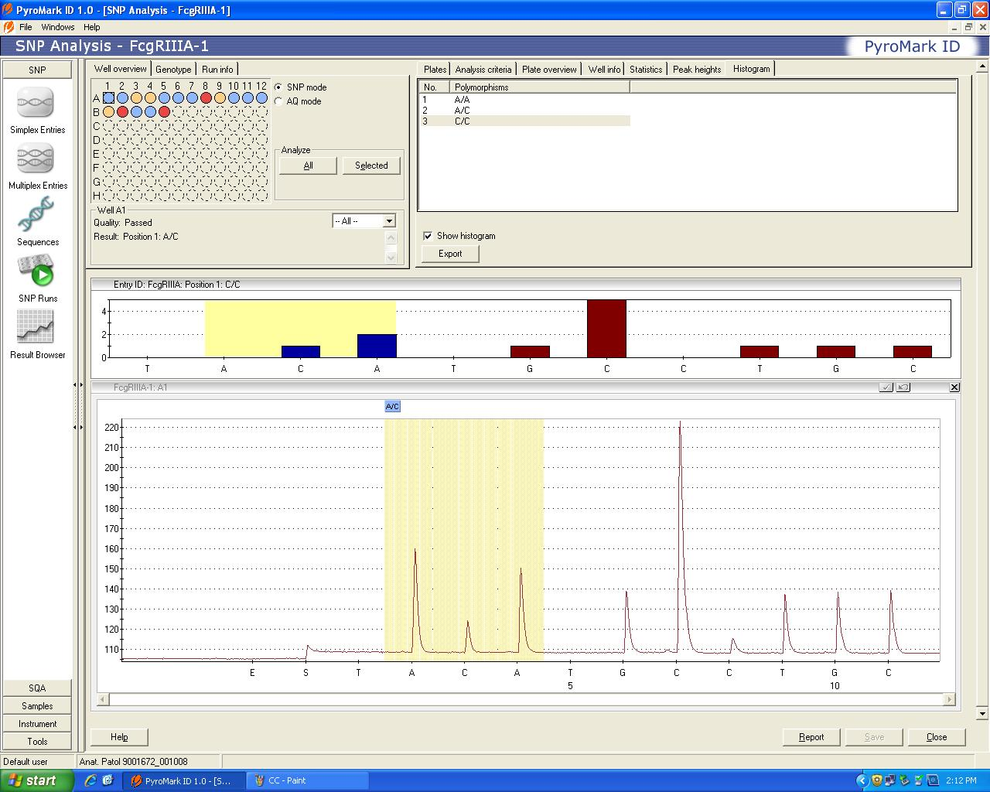
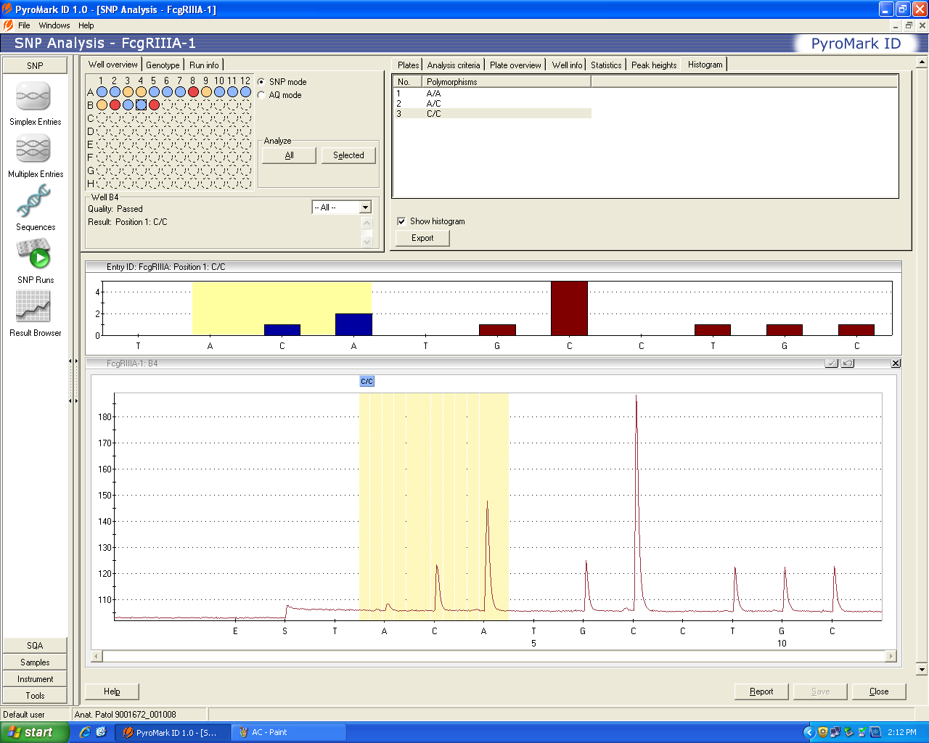
FcgRIIIa F158V Polymorphism
A/C
C/C

Slide 32
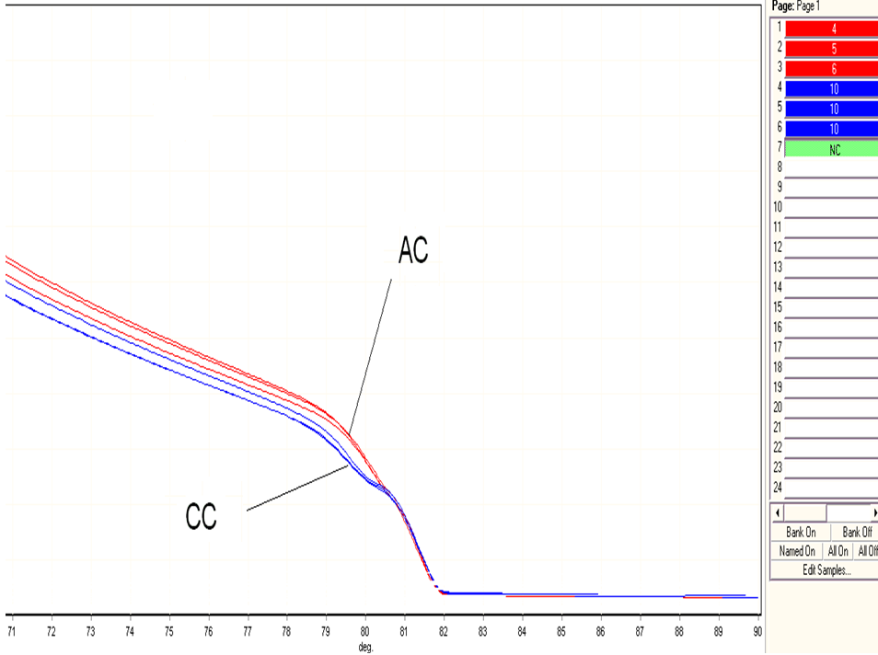
High Resolution Melting (HRM)

Slide 33
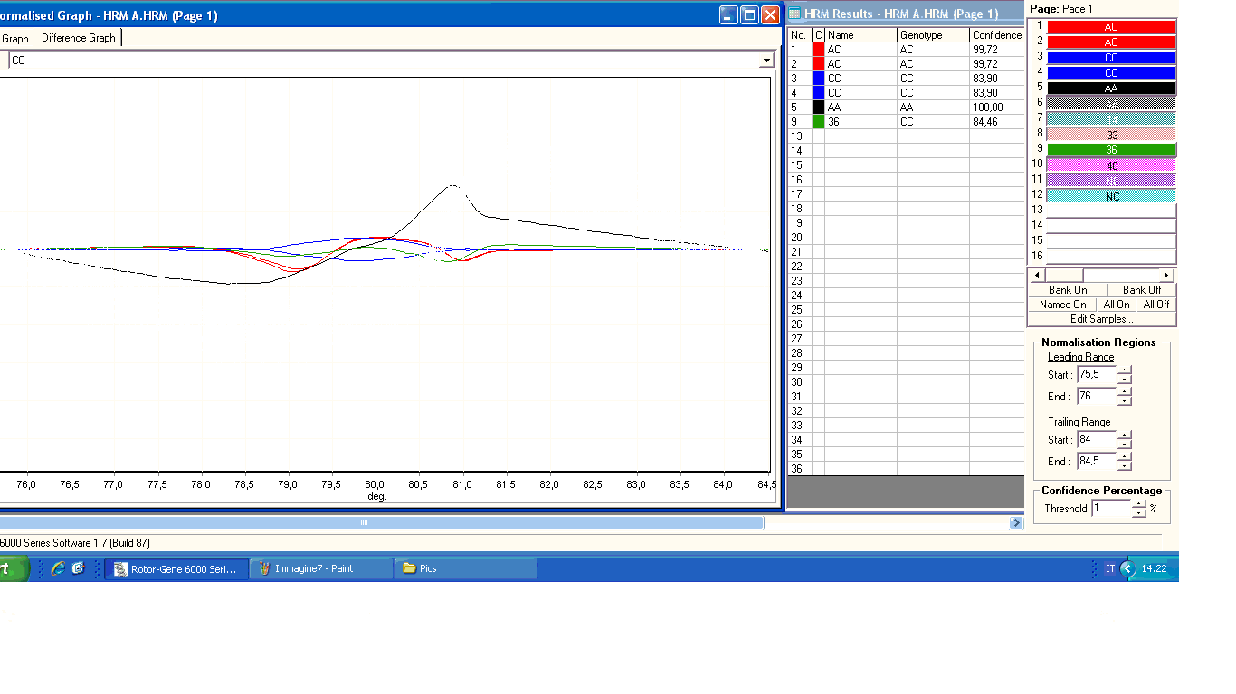

Slide 34
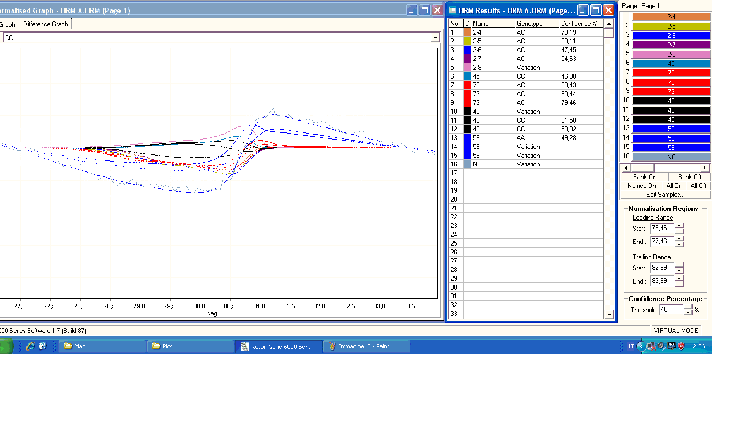

Slide 35
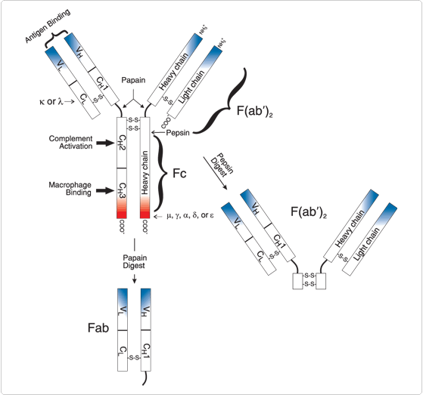
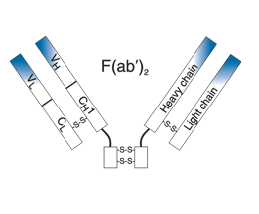
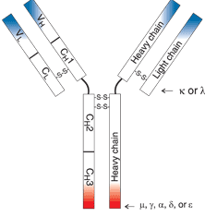
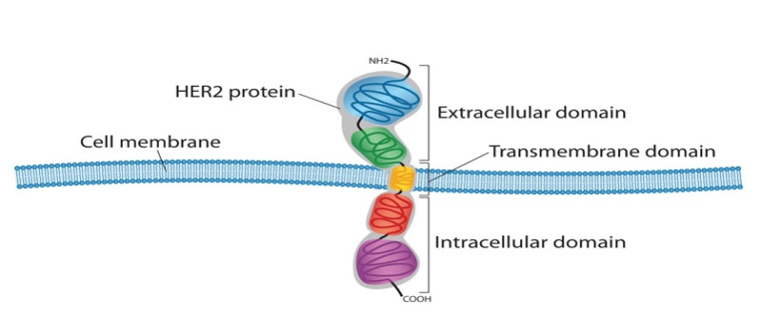
IgG and Fab attack equally

Slide 36
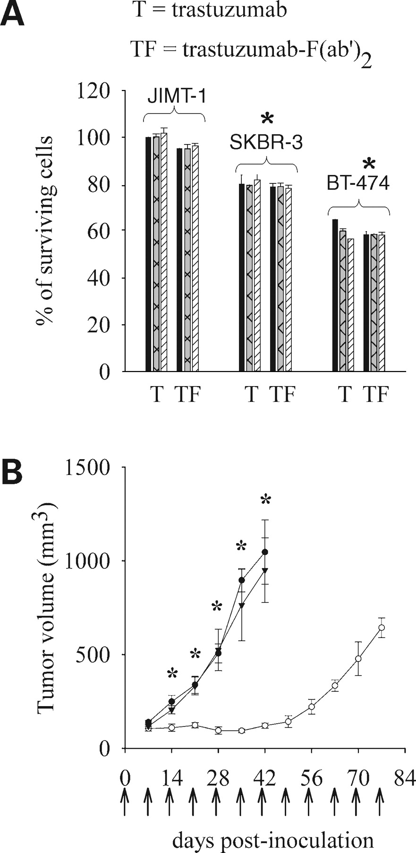

In vitro and in vivo effects of trastuzumab-F(ab′)2.
In vitro
Saline
Fab’
IgG
In vivo
Barok M et al. Mol Cancer Ther 2007;6:2065-2072
©2007 by American Association for Cancer Research
Notes:
In vitro and in vivo effects of trastuzumab-F(ab′)2. A, trastuzumab-F(ab′)2 acts in vitro similar to whole trastuzumab. Trastuzumab-F(ab′)2 inhibited the growth of trastuzumab-sensitive cell lines SKBR-3 and BT-474 in vitro as effectively as trastuzumab IgG. JIMT-1 cells were resistant in vitro to both trastuzumab-IgG and trastuzumab-F(ab′)2. T, trastuzumab; TF, trastuzumab-F(ab′)2. Doses: black column, 1 μg/mL; cross-hatched column, 10 μg/mL; hatched column, 100 μg/mL. Neither trastuzumab whole IgG nor trastuzumab-F(ab′)2 fragment had any inhibitory effect on JIMT-1 cells in vitro, whereas both had significant inhibitory effect on SKBR-3 and BT-474 cells as compared with their effect on JIMT-1 cells. *, P < 0.05. B, lack of effect of trastuzumab-F(ab′)2 on JIMT-1 xenografts. SCID mice injected s.c. with 5 × 106 JIMT-1 cells were treated i.p. on a weekly basis (arrows) with saline (•, n = 8), trastuzumab IgG (○, n = 8), or trastuzumab-F(ab′)2 (▾, n = 8), starting on the day of inoculation. Tumor growth was significantly reduced in the trastuzumab-treated group versus the saline-treated group between days 14 and 42. *, P < 0.05. There was no significant difference between the trastuzumab-F(ab′)2 and the saline-treated groups.

Slide 37
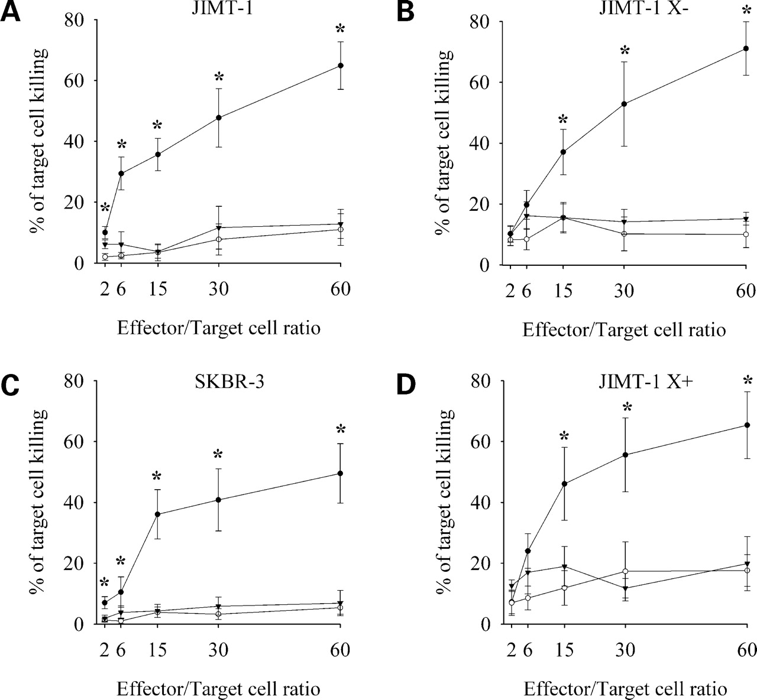
In vitro trastuzumab-mediated ADCC against ErbB2-positive tumor cells.
IgG
Fab′
rituximab
IgG
Fab′
rituximab
Anti CD20 –B-cell (Lymphoma)
Barok M et al. Mol Cancer Ther 2007;6:2065-2072
©2007 by American Association for Cancer Research
Notes:
In vitro trastuzumab-mediated ADCC against ErbB2-positive tumor cells. Target tumor cells [(A) JIMT-1; (B) JIMT-1 X−; (C) SKBR-3; (D) JIMT-1 X+] were labeled with CFDA, SE, then mixed with PBMCs freshly isolated from peripheral blood at effector/target ratios of 2:1, 6:1, 15:1, 30:1, and 60:1. Trastuzumab (•), trastuzumab-F(ab′)2 (▾), or rituximab (○) were added to the mixed samples at a concentration of 100 μg/mL. After an 8-h incubation at 37°C, samples were stained with propidium iodide and analyzed by flow cytometry. The percentage of killed cells was calculated as described in Materials and Methods. In all cell lines, tumor cell killing was significantly higher in the presence of trastuzumab whole IgG than that observed in the presence of trastuzumab-F(ab′)2 fragment when the effector/target cell ratio was 15 or above. *, P < 0.05. No significant difference was observed between the effects of rituximab and trastuzumab-F(ab′)2. Similarly, no significant differences were observed among the cell lines in the killing effect of trastuzumab-mediated ADCC.

Slide 38
FcgRIIIa F158V SNP
3 %
65 %
32 %
F/F
F/V
V/V

Slide 39
FcgRIIa R131H SNP

Slide 40
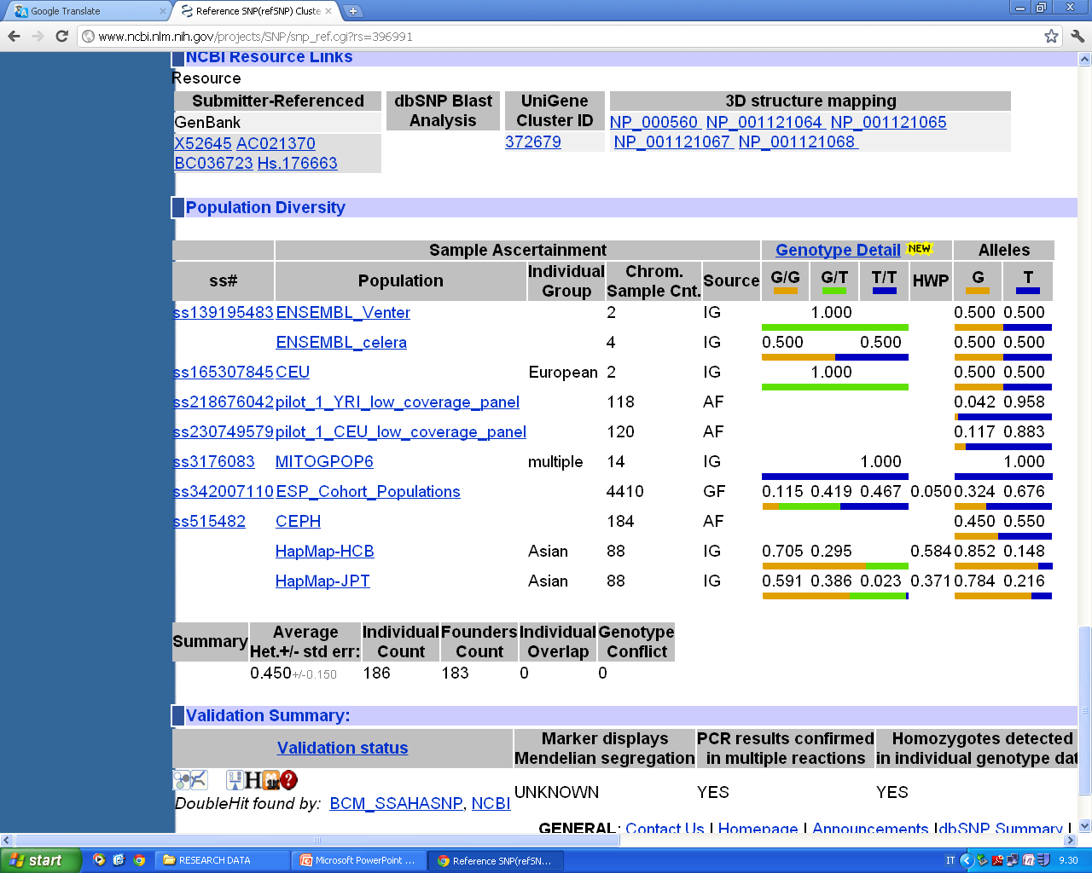
V/V
F/V
F/F

Slide 41
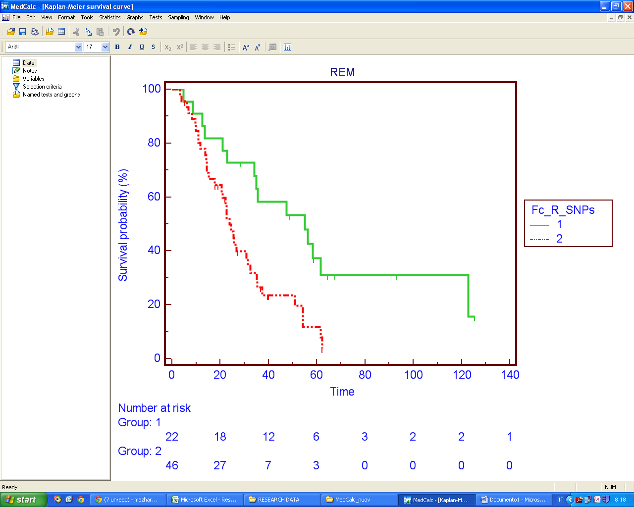
P = 0.0037
Over All Survival (OS)
V/V or H/H
F/V or H/R

Slide 42
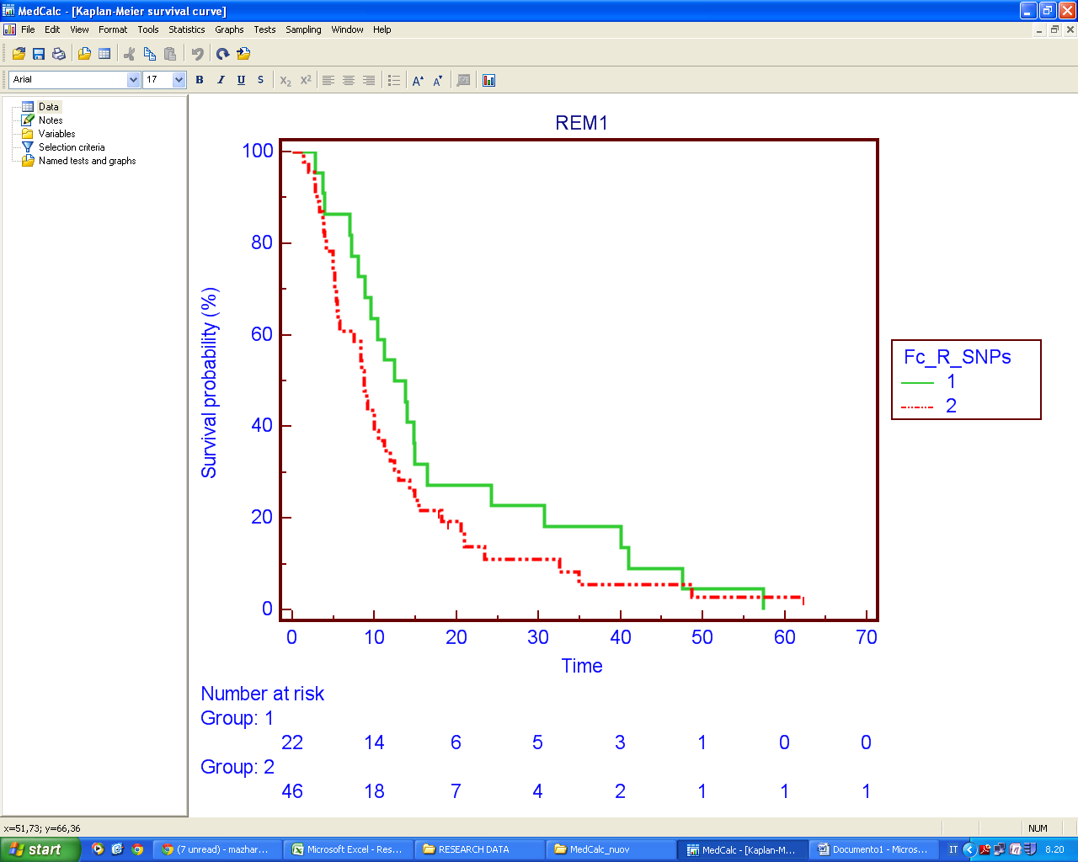
P > 0.05
PFS-I

Slide 43
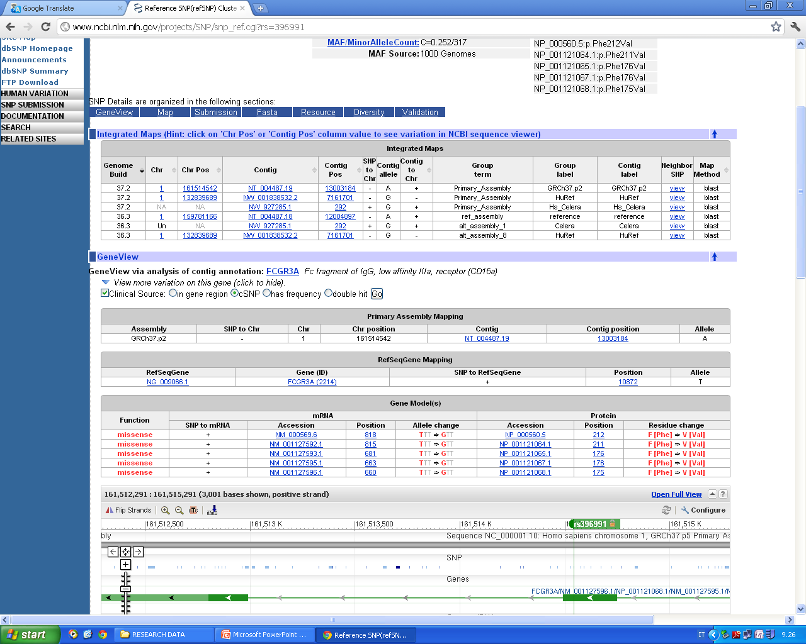

Slide 44
PIK3CA/Akt Pathway and
FcgRIIIa
Impact on Over All Servival (OS)

Slide 45
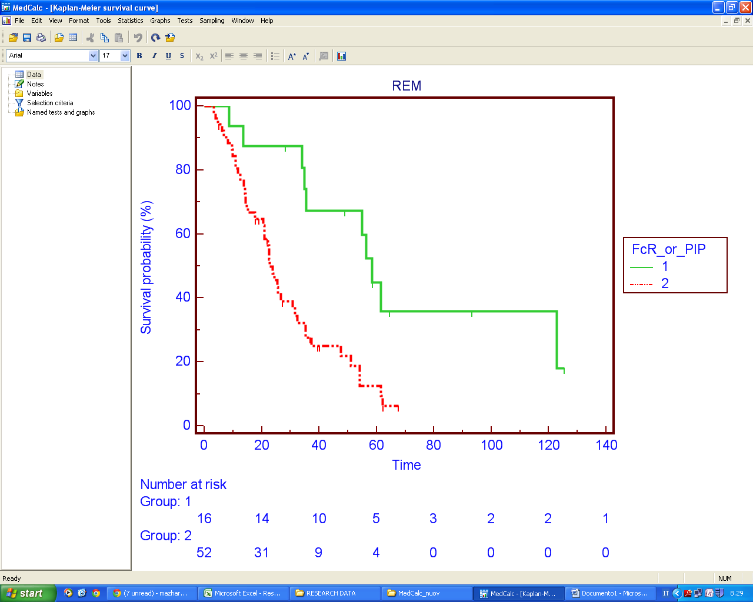
OS
P = 0.0012
WT or V/V or H/H
Mut or F or R

Slide 46
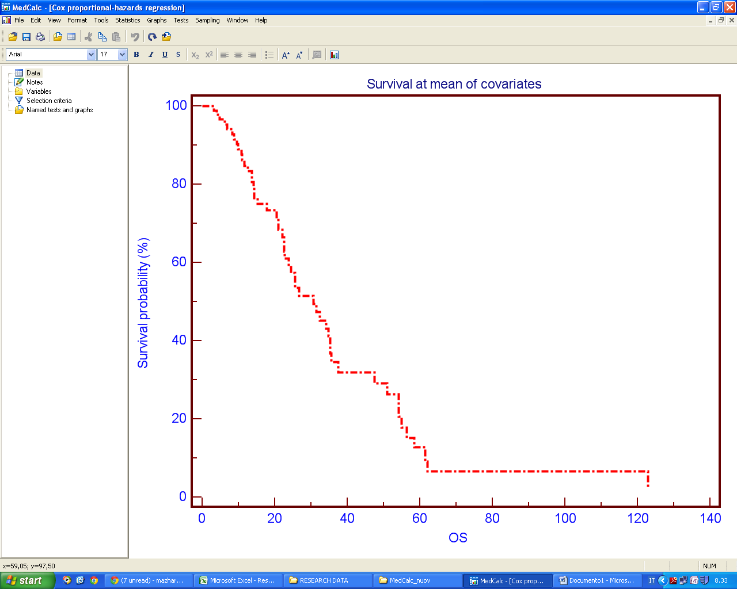
P = 0.0009
?
COX proportional analysis of PIK3CA/Akt1 pathway and FcgR SNPS

Slide 47
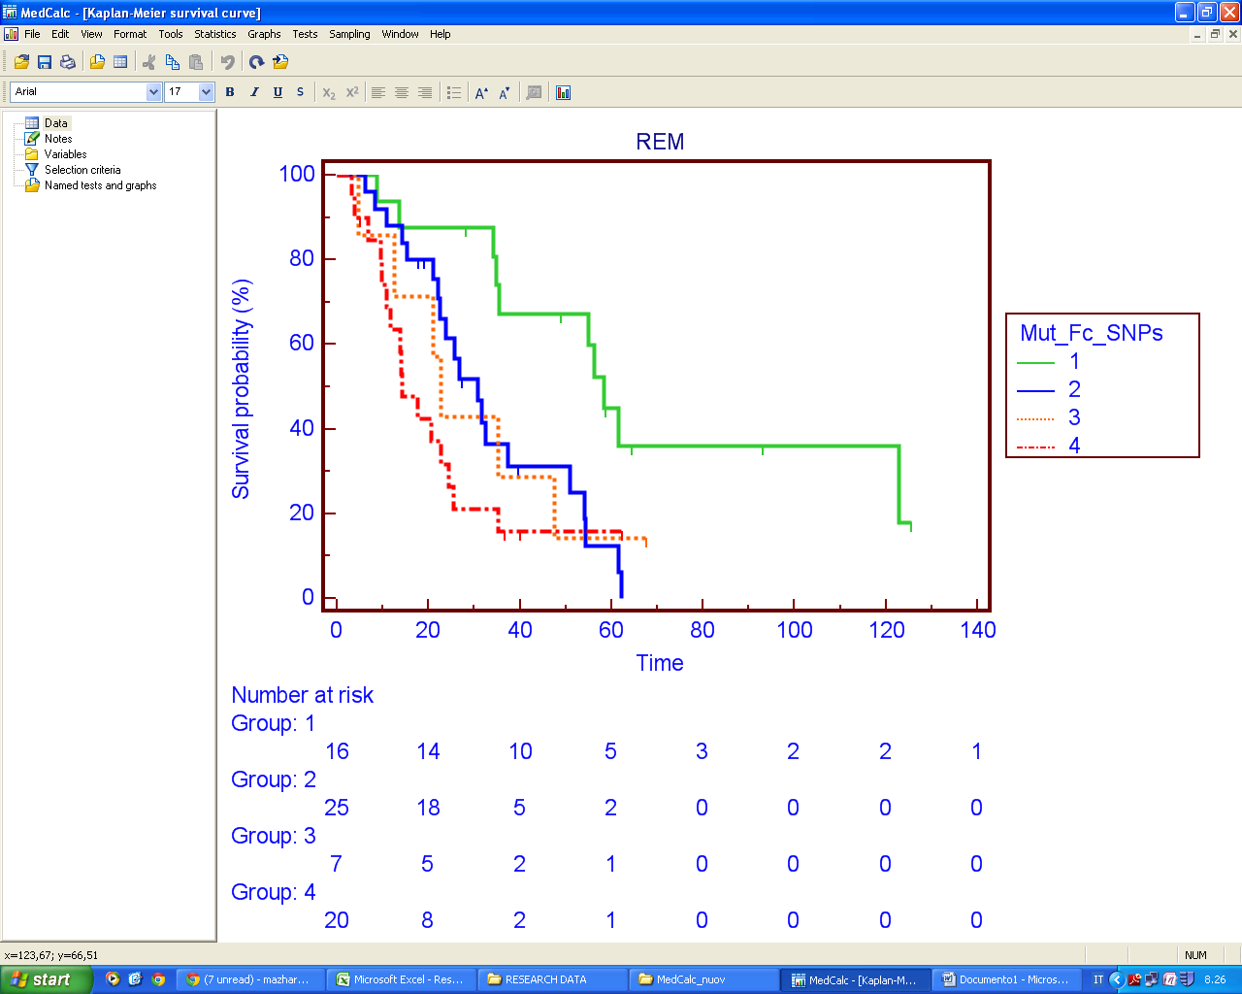
OS
P = 0.0069
Wt
and
F or R
Wt and VV/HH
Mut
and
F or R
Mut
and
VV/HH

Slide 48
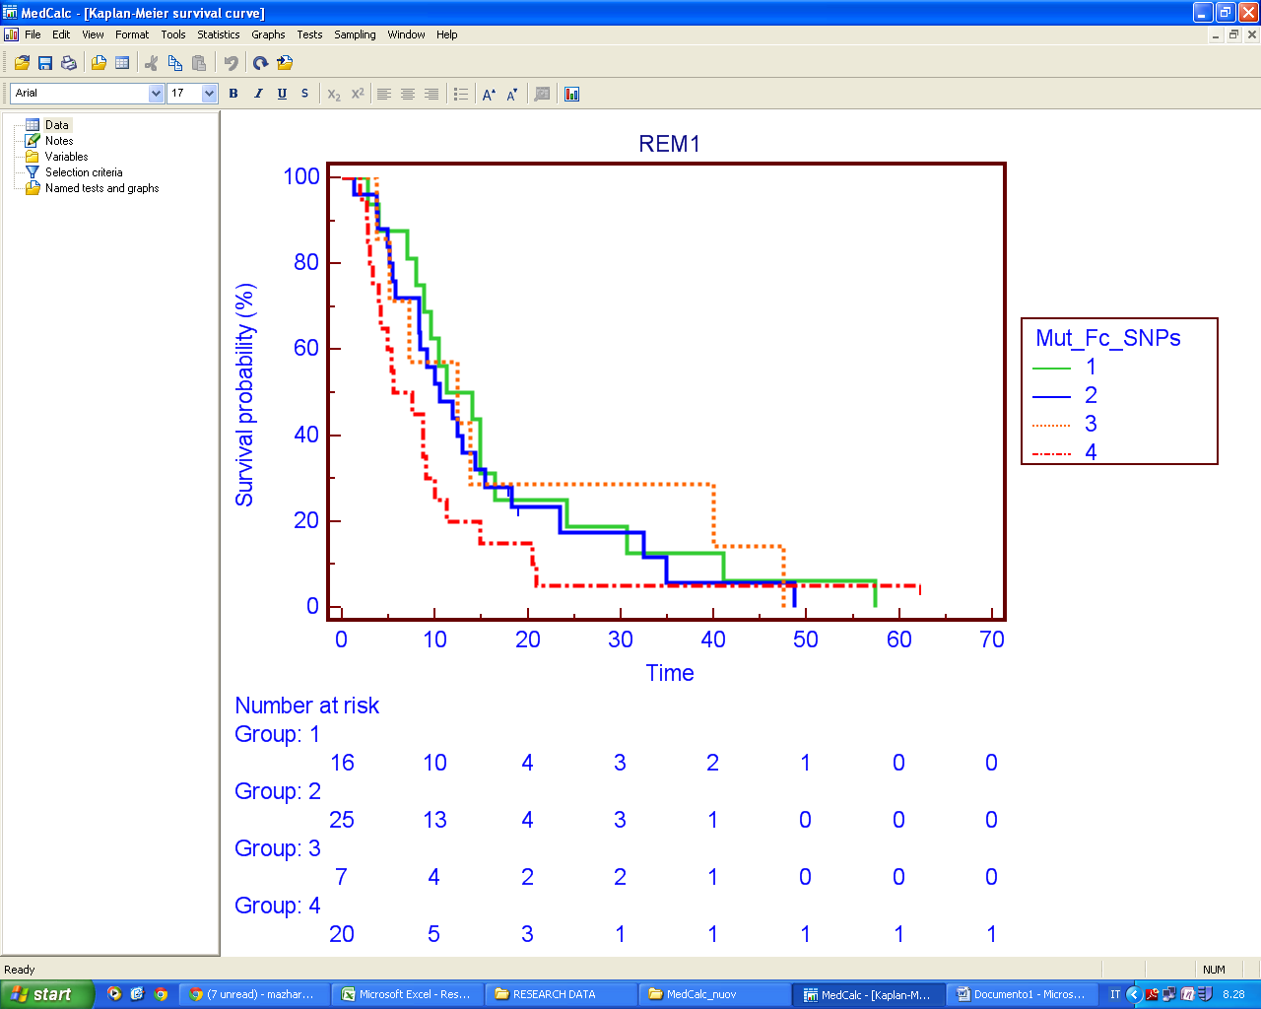
P > 0.05
PFS-I
Mut
and
F or R

Slide 49
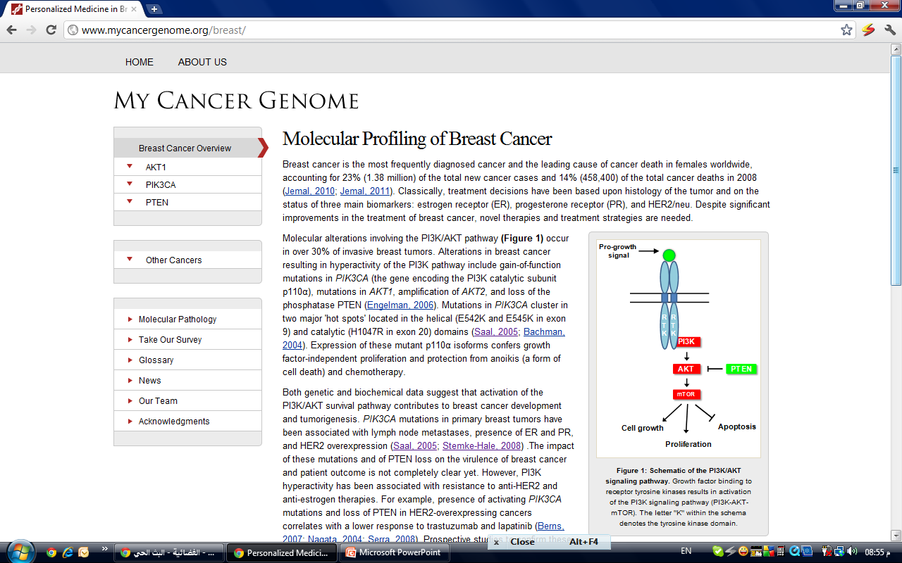

Slide 50
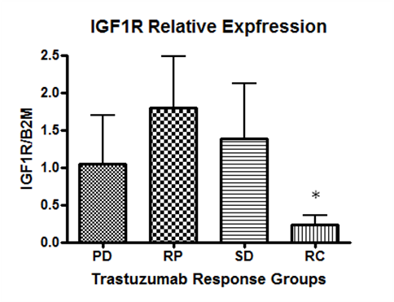
IGF-R1 expression

Slide 51
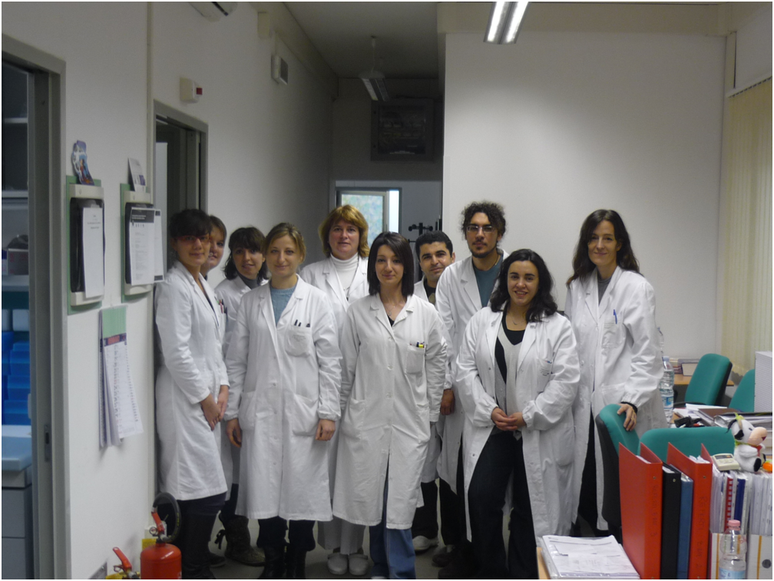
If I did something perfect, it’s because I have the following team, otherwise it was my fault…….

Slide 52
